Slide 1

Capstone Project Phase A
Idiopathic pulmonary fibrosis
classification using optimized
Convolutional Neural Network
Alex Baboshin 310926415
Asaf Shnaider 316468636
(24-2-R-9)
Supervisor:
Prof. Miri Weiss Cohen

Slide 2
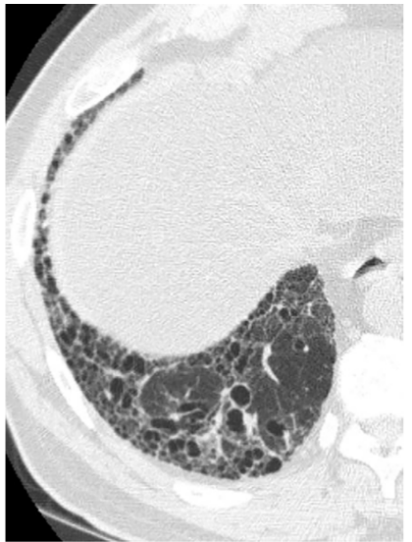
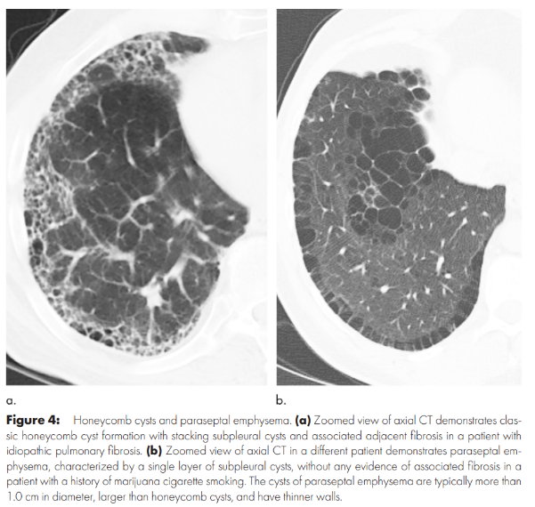
Introduction
Idiopathic Pulmonary Fibrosis (IPF)
IPF is a terminal disease that progressively causes scarring of the lungs, impairs the ability to breathe, chronic coughing and severe discomfort in daily life.
There is no cure for pulmonary fibrosis, by the time IPF reaches a critical stage, it is often too late for effective treatment.
Honeycombing: Clustered cysts in the lungs that make it difficult to breathe.
Reticular Patterns: Mesh-like structures that appear in lung scans, indicating scarring.
Our system will use convolutional neural networks (CNNs) to detect early signs of IPF more accurately than human assessment.

Slide 3
Motivation
Our goal is to reduce patient suffering by developing an AI system that supports doctors in diagnosing Idiopathic Pulmonary Fibrosis (IPF) quickly and accurately, enabling earlier treatment and improving outcomes.
By streamlining diagnostics, we reduce delays, enhance efficiency in healthcare, and allow doctors to focus more on treatment decisions.

Slide 4
Proposal for Partial Solution
We propose a deep neural network systems that identifies patterns in lung CT scans, often undetectable by the human eye.
Trained on a large dataset, the system continuously improves in diagnosing IPF and detecting early signs of fibrosis.
By providing a second opinion, it supports doctors in making faster, more accurate diagnoses, ensuring no subtle signs are missed.

Slide 5
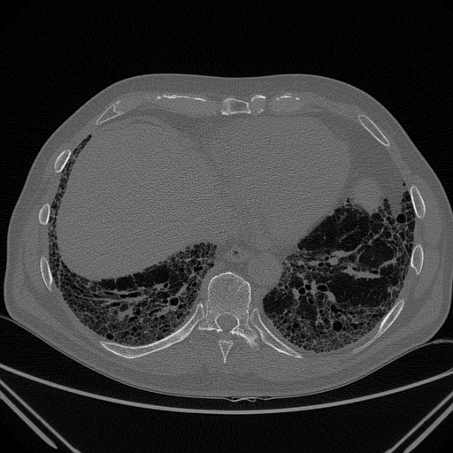
Data Set
Data Source
Dataset used from kaggle OSIC Pulmonary Fibrosis Progression - Predict lung function decline.
The data originally used to predict a patient’s severity of decline in lung function based on a CT scan of their lungs.
Dataset Details
Total number of files: 34,290.
Training set: We used X files to train the deep learning model.
Test set: The model was evaluated using X files to assess its performance.
Data Format
The lung scans were converted from DICOM format to PNG for easier processing and analysis.
The dataset includes baseline CT scans as well as follow-up scans taken over a period of 1–2 years to monitor lung function.

Slide 6
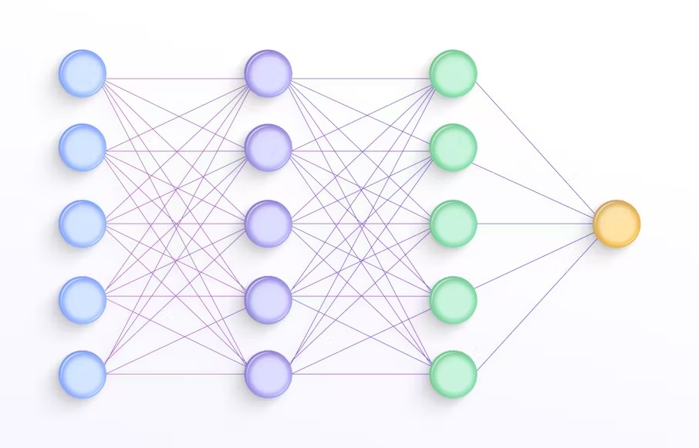
Convolutional Neural Networks (CNN)
What is a CNN?
A Convolutional Neural Network (CNN) is a type of deep learning algorithm primarily used for tasks involving visual data, such as image and pattern recognition, classification, and segmentation.
key components of a CNN:
Convolutional Layers- It applies filters to the input data to extract essential features. For images, the filters could detect patterns like edges or colors.
Pooling Layers- Pooling layers reduce the spatial dimensions of the feature maps (result of convolution operation).
Activation Functions- After the convolution and pooling layers, an activation function is applied introduces non-linearity to the model enabling it to learn more complex patterns.

Slide 7
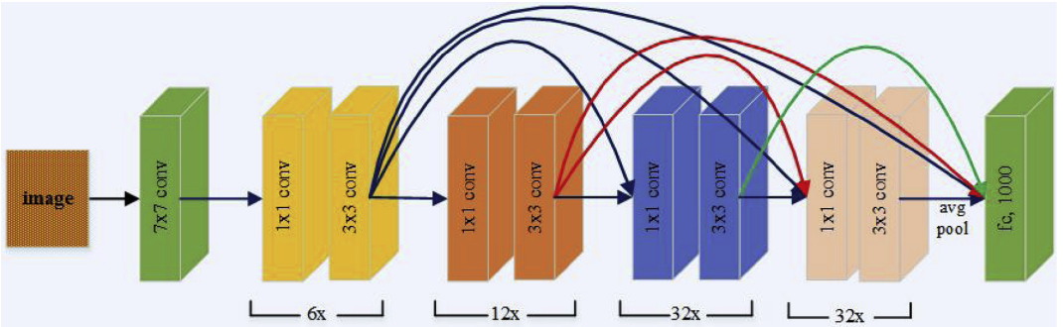
DenseNet Architecture
DenseNet: Densely connected Convolutional Networks.
DenseNet is a deep network known for its high performance in image classification tasks.
DenseNet connects each layer to every other layer, ensuring efficient feature reuse and improving accuracy.
DenseNet alleviates the vanishing gradient problem, which often plagues deep networks by allowing gradients to travel more directly between layers.
Why DenseNet for IPF Detection?
DenseNet is known for its high accuracy in medical image classification.
In our project, we aim to further improve DenseNet by building a system that not only achieves high accuracy but also detects IPF at earlier stages than current models.

Slide 8
Process: Hyperparameter Optimization
To train our CNN, we need to optimize several hyperparameters:
Learning Rate: How quickly the model updates its weights.
Batch Size: The number of training examples in each batch.
Dropout Rate: The proportion of neurons ignored during training to prevent overfitting.
Epochs: The number of complete passes through the entire training dataset during the training process
The learning rate, batch size, dropout rate, and number of epochs are crucial in model training, as each parameter affects the model’s performance based on the dataset and specific architecture.
Using Transfer Learning
Transfer learning is the improvement of learning in a new task through the transfer of knowledge from a related task that has already been learned.
This allows us to start from a stronger baseline and improves our model’s ability to classify IPF accurately.
Notes:
Overfitting-model learns the training data too well but fails to generalize new unseen data

Slide 9
Process: Hyperparameter Optimization
Finding the Optimal Combination
Learning rate is good in determining the model's convergence. A too-high learning rate may cause the model to miss optimal points, while a too-low rate may result in slow training.
The goal is to find an optimal combination of hyperparameters that results in minimal error.
We will experiment with different combinations of:
Learning rates: 5e-4, 5e-5, 5e-6.
Batch sizes: 32 vs 64.
Dropout rates: 0.2 to 0.5.
Epoch sizes: range from 50 to 150.
Through experimentation, we aim to achieve a model with low error and high accuracy.

Slide 10
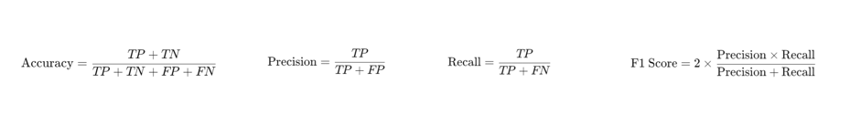
Measures of Model Performance
How We Measure Performance
Accuracy: The ratio of correct predictions (both positive and negative) to total predictions.
Precision: The percentage of positive identifications that were correct.
Recall (Sensitivity): The ability of the model to correctly identify positive cases.
F1 Score: The harmonic mean of precision and recall, providing a balance between the two, especially important for imbalanced datasets.

Slide 11
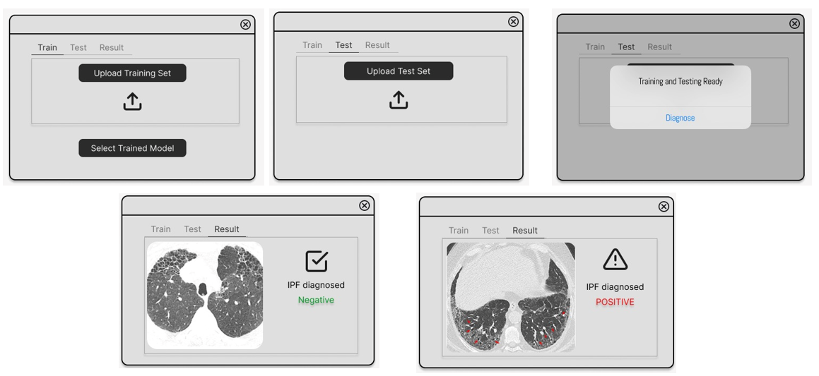
GUI

Slide 12
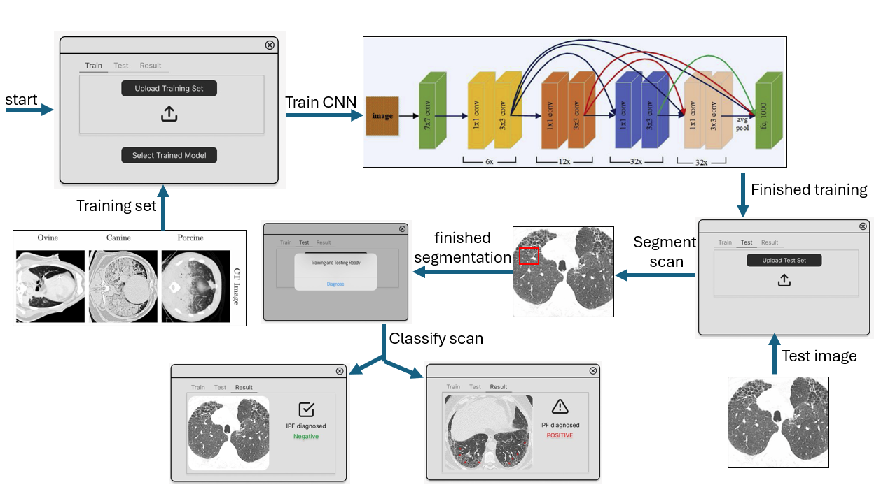
flow

Slide 13
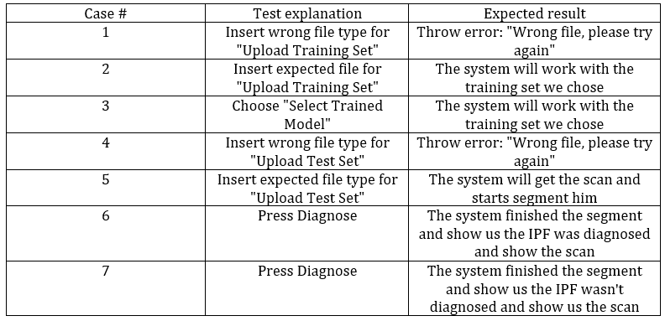
Evaluation / Verification plan

Slide 14
Conclusion
Key Takeaways
Idiopathic Pulmonary Fibrosis (IPF) is a serious, terminal disease that requires early detection for effective treatment.
Our system, based on deep neural networks, aims to detect IPF in its early stages, helping doctors diagnose more accurately and faster than traditional methods.
DenseNet and Transfer Learning provide a powerful framework for improving medical imaging diagnostics.
Looking Forward
Through hyperparameter optimization and continuous training, our model aims to achieve high accuracy with low error rates.

Slide 15
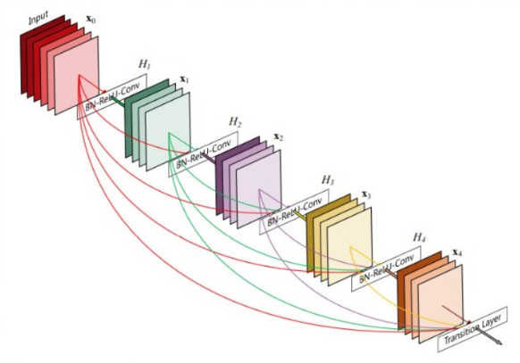
Questions & Answers
Thanks for listening!
Alex & Asaf

